Slide 1
DESKTOP VOICE ASSISTANT
GUIDED BY,
Er. S. RAMYA.,M.E/Ass Prof
AUTHOR,
RAGESH.V
PAVITHRA.K

Slide 2
INTRODUCTION
Artificial Intelligence (AI) systems organize a natural human-machine interaction (through voice, communication, gestures, facial expressions, etc.) are gaining in popularity.
By automating certain tasks and providing real time insights, AI
can help organizations make faster and more informed decisions.
A Virtual Assistant is an application that understands Natural Language Voice commands and completes tasks for the users.

Slide 3
ABSTRACT
Voice assistants are software agents that can interpret human speech and response via synthesized voices.
Apple’s SIRI , Amazon’s Alexa , Microsoft’s Cortana and Google assistant are the most popular voice assistants and are embedded in smart phones and dedicated speakers.
Users can ask their assistants questions , control home automation devices and media playback via voice and manage other basic task such as email, to-do lists, and calendars with verbal commands.

Slide 4
OBJECTIVE
The main purpose of an intelligent virtual assistant is to answer questions that users may have. This may be done in a business environment, for example, on the business website, with a chat interface
On the mobile platform, the intelligent virtual assistant is available as a call-button operated service where a voice asks the user “What can I do for you?” and then responds to verbal input.

Slide 5
EXISTING SOFTWARE
SIRI from apple
Google assistant from Google
Cortana from Microsoft
Alexa from Amazon

Slide 6
DRAWBACKS
It needs internet facility.
It will take some time to put to-do list
It can’t read or send emails.
No assurance of your data’s security.

Slide 7
PROPOSED SYSTEM
The work started with analyzing the audio commands given by the users through the microphone.
This can be anything like getting any information, operating a computer’s internal files etc.
This voice assistant can work with internet or without internet. In the mode of using this voice assistance without internet you can not able to you certain commands working based on the internet.
The most of the commands will works on the mode of without internet.

Slide 8

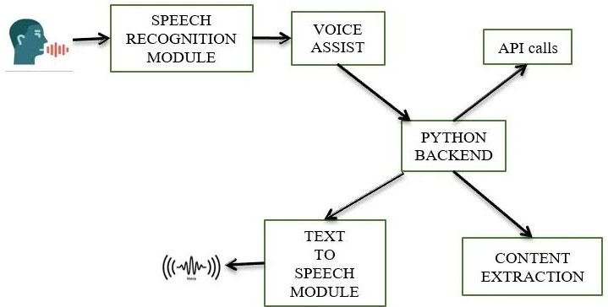
SYSTEM ARCHITECTURE

Slide 9
Hello Bestee!

Slide 10
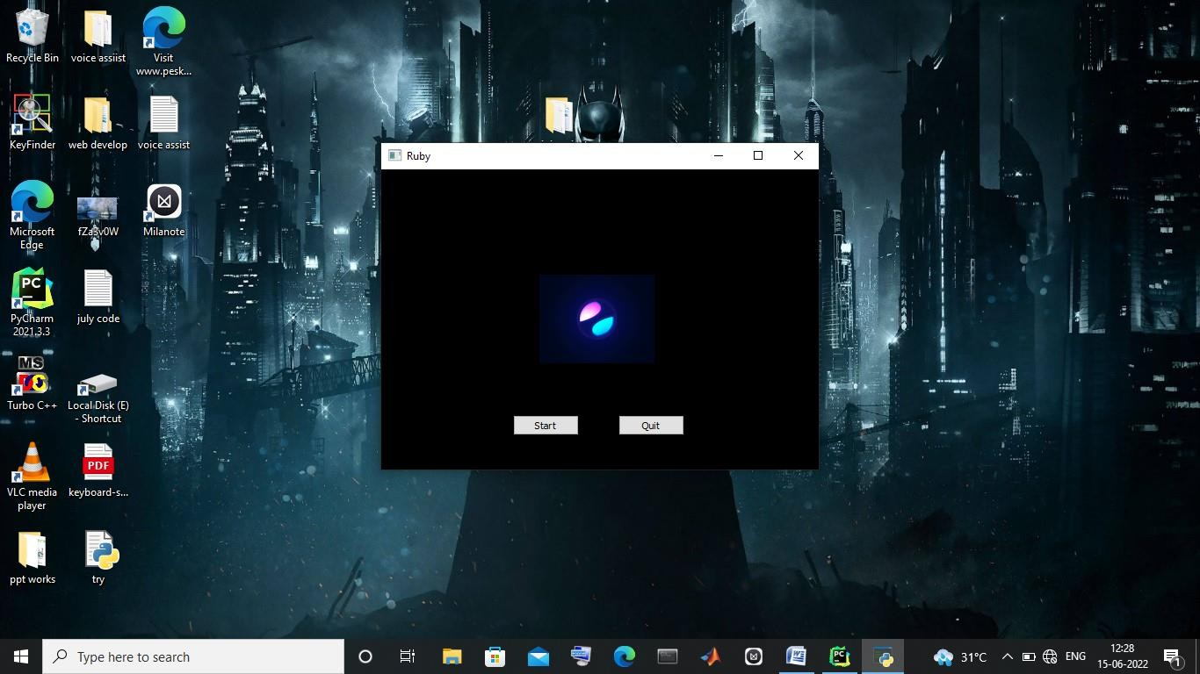
SAMPLE SCREENSHOTS
Execution of proposed voice assistant Software

Slide 11
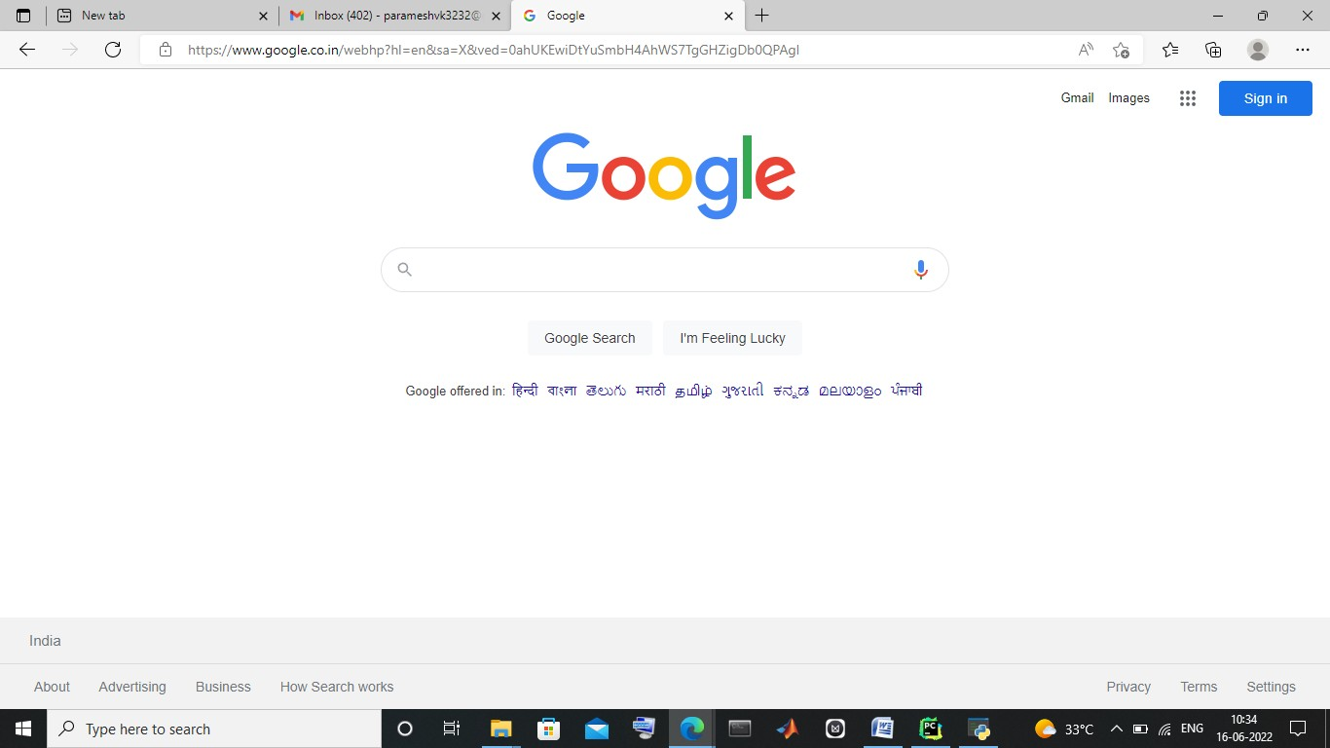
Executing “Open Google” voice command

Slide 12
CONCLUSION
In this paper “Desktop Virtual Assistant” we discussed the design and implementation of Digital Assistance.
The project is built using open source software modules with PyCharm community backing which can accommodate any updates shortly.
The modular nature of this project makes it more flexible and easy to add additional features without disturbing current system functionalities.

Slide 13
THANK YOU
Notes:
You can safely remove this slide. This slide design was provided by SlideModel.com – You can download more templates, shapes and elements for PowerPoint from http://slidemodel.com/

